Slide 1


MALLA REDDY COLLEGE OF ENGINEERING & TECHNOLOGY (AUTONOMUS INSTITUTION –UGC, GOVT. OF INDIA) Affiliated to JNTUH; Approved by AICTE, NBA-Tier 1 & NAAC with A-GRADE| ISO 9001:2015
MULTI-SOURCE INTELLIGENT RETRIEVAL AUGMENTED GENERATION SYSTEM USING LOCAL LLM
Team Members Details
1.R.Koushik –22N31A66F3
2.V.Sreeja –22N31A66J0
3.S.Vennela –22N31A66J4
IV Year B.Tech-I Semester – CSE (AIML)
Under the Guidance of
Dr. T. Shiva Ratna Sai
Associate Professor
B.Tech IV Year – II Sem | Dept of Computational Intelligence| Project Phase - II | Project Review

Slide 2

Agenda
MALLA REDDY COLLEGE OF ENGINEERING AND TECHNOLOGY
Abstract
Introduction
Existing System
Proposed System
System Architecture
Requirements Specifications
System Models
Implementation
References
B.Tech IV Year – II Sem | Dept of Computational Intelligence| Project Phase - II | Project Review

Slide 3
Abstract
MALLA REDDY COLLEGE OF ENGINEERING AND TECHNOLOGY
The rapid growth of unstructured information across documents, web pages, and videos has made it difficult to retrieve precise, contextual answers from heterogeneous sources. This project develops a fully local Multi-Source Intelligent Retrieval-Augmented Generation (RAG) System that ingests data from five source types PDF, DOCX, TXT, web URLs, and YouTube transcripts and answers natural-language queries without relying on cloud APIs, ensuring complete data privacy and offline operation. The system is built using LangChain for orchestration, ChromaDB as the local vector store, HuggingFace all-MiniLM-L6-v2 for embeddings, and Ollama with the llama3.2 model for on-device language generation. A unified ingestion pipeline normalizes documents into chunked, metadata-rich representations, while a Maximal Marginal Relevance (MMR) retriever selects diverse, relevant context for the LLM. The application is exposed through a FastAPI backend and Streamlit frontend, enabling document uploads and source-grounded answers in real time. An LLM-as-a-judge evaluation module measures faithfulness, answer relevance, and context relevance.
Dataset: User-supplied multi-format corpus (PDF, DOCX, TXT, Web URLs, YouTube transcripts)
B.Tech IV Year – II Sem | Dept of Computational Intelligence| Project Phase - II | Project Review

Slide 4
Introduction
MALLA REDDY COLLEGE OF ENGINEERING AND TECHNOLOGY
The exponential rise of digital information across documents, web pages, and multimedia has created an urgent need for systems that can retrieve and reason over heterogeneous data meaningfully. Traditional keyword search often fails to capture user intent, while modern Large Language Models (LLMs), though powerful, are prone to hallucinations and lack grounding in user-specific data. Retrieval-Augmented Generation (RAG) addresses these limitations by combining the contextual understanding of LLMs with the factual precision of information retrieval. However, most existing RAG solutions depend on cloud APIs, raising concerns over data privacy, cost, and offline accessibility. This project presents a Multi-Source Intelligent RAG System Using Local LLMs, a fully offline question-answering platform that ingests information from five source types: PDF, DOCX, TXT, web URLs, and YouTube transcripts. It leverages LangChain for orchestration, ChromaDB as the local vector store, HuggingFace all-MiniLM-L6-v2 for embeddings, and Ollama with llama3.2 for on-device generation. A FastAPI backend and Streamlit frontend enable real-time document upload and querying, while an LLM-as-a-judge evaluation module measures faithfulness, answer relevance, and context relevance, demonstrating how privacy-preserving. RAG can deliver grounded, reliable answers across diverse domains.
B.Tech IV Year – II Sem | Dept of Computational Intelligence| Project Phase - II | Project Review

Slide 5
Existing System
MALLA REDDY COLLEGE OF ENGINEERING AND TECHNOLOGY
Cloud-Based RAG Platforms (OpenAI ChatGPT, Google Gemini, Perplexity AI)
- Provide question answering over user-uploaded documents using cloud LLMs.
- Require constant internet access and send user data to external servers.
LangChain + OpenAI API Implementations
- Widely used for building RAG pipelines with GPT-3.5/GPT-4 models. - Depend on paid API keys and external embeddings (OpenAI Ada). Pinecone / Weaviate Vector Databases
- Cloud-hosted vector stores used for semantic search at scale.
- Charge per query and require account setup and network availability.
Microsoft Copilot / Notion AI
- Offer document Q&A inside their proprietary ecosystems.
- Locked to specific file formats and subscription plans.
YouTube Transcript Search Tools (Eightify, Glasp)
- Summarize videos using cloud LLMs.
- Limited to a single source type and require login/credits.
B.Tech IV Year – II Sem | Dept of Computational Intelligence| Project Phase - II | Project Review

Slide 6
Drawbacks of Existing System
MALLA REDDY COLLEGE OF ENGINEERING AND TECHNOLOGY
- Privacy Risk: User documents and queries are sent to third-party servers, exposing sensitive data.
- Recurring Cost: Cloud LLM APIs and managed vector databases charge per token or per query.
- Internet Dependency: Cannot operate offline; unusable in air-gapped or low-connectivity environments.
- Limited Source Coverage: Most tools handle only one or two file formats and ignore web/YouTube
content.
- Vendor Lock-in: Closed ecosystems make it hard to switch models, embeddings, or storage backends.
- Hallucinations: Pure LLM systems without retrieval often fabricate facts and lack source attribution.
- Scalability Cost: Storing large corpora in cloud vector DBs becomes expensive as data grows.
B.Tech IV Year – II Sem | Dept of Computational Intelligence| Project Phase - II | Project Review

Slide 7
Proposed System
MALLA REDDY COLLEGE OF ENGINEERING AND TECHNOLOGY
Develop a fully local Multi-Source Intelligent RAG System using open-source LLMs.
Ingest data from five source types: PDF, DOCX, TXT, web URLs, and YouTube transcripts.
Implement and integrate the following components:
LangChain — pipeline orchestration and prompt management
ChromaDB — local on-disk vector database
HuggingFace all-MiniLM-L6-v2 — sentence embeddings
Ollama + llama3.2 — on-device language generation
Use a unified ingestion pipeline that chunks, embeds, and stores documents with rich metadata.
Apply Maximal Marginal Relevance (MMR) retrieval for diverse, context-rich answers.
Expose the system through a FastAPI backend and a Streamlit frontend for real-time interaction.
Provide an LLM-as-a-judge evaluation module measuring faithfulness, answer relevance, and context relevance.
Aim to deliver accurate, private, and source-attributed question answering without any cloud dependency.
B.Tech IV Year – II Sem | Dept of Computational Intelligence| Project Phase - II | Project Review

Slide 8
Advantages of Proposed System
MALLA REDDY COLLEGE OF ENGINEERING AND TECHNOLOGY
Complete Privacy: All data, embeddings, and inference stay on the user's machine — nothing leaves the device.
Zero Recurring Cost: No API keys, subscriptions, or per-query charges.
Offline Capability: Fully functional without internet after initial setup.
Multi-Source Support: Unifies PDF, DOCX, TXT, Web, and YouTube content into one searchable knowledge base.
Source-Grounded Answers: Every response cites the originating chunk, eliminating hallucinations.
Modular & Open Source: Built on LangChain, ChromaDB, and Ollama — easy to swap models or extend.
Interactive UI: Streamlit frontend enables real-time uploads, queries, and source inspection.
Self-Evaluating: Built-in LLM-as-judge metrics validate answer quality automatically.
B.Tech IV Year – II Sem | Dept of Computational Intelligence| Project Phase - II | Project Review

Slide 9
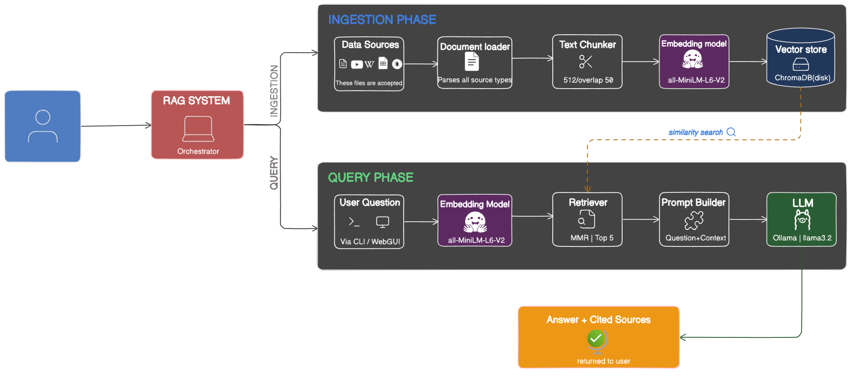
System Architecture
MALLA REDDY COLLEGE OF ENGINEERING AND TECHNOLOGY
B.Tech IV Year – II Sem | Dept of Computational Intelligence| Project Phase - II | Project Review

Slide 10
Requirements Specification
MALLA REDDY COLLEGE OF ENGINEERING AND TECHNOLOGY
B.Tech IV Year – II Sem | Dept of Computational Intelligence| Project Phase - II | Project Review

Slide 11
MALLA REDDY COLLEGE OF ENGINEERING AND TECHNOLOGY
Software Requirement Specifications (SRS)
Operating System: Windows 10 or above / Linux / macOS
Programming Language: Python 3.11
IDE: Visual Studio Code 1.75 or later
LLM Runtime: Ollama (with llama3.2 model)
Vector Database: ChromaDB
Embedding Model: HuggingFace all-MiniLM-L6-v2
Frontend Framework: Streamlit
Version Control: Git / GitHub
B.Tech IV Year – II Sem | Dept of Computational Intelligence| Project Phase - II | Project Review

Slide 12
Hardware Requirement Specifications (HRS)
MALLA REDDY COLLEGE OF ENGINEERING AND TECHNOLOGY
- CPU: Intel Core i5 or AMD Ryzen 5+
- RAM: 8GB+ (16GB recommended for local LLM)
- GPU: NVIDIA GPU with 4GB+ VRAM for faster inference (Optional)
- Storage: 20GB+ free SSD space (for models, ChromaDB index, and documents)
- Internet: Required only for initial setup and dependency download
B.Tech IV Year – II Sem | Dept of Computational Intelligence| Project Phase - II | Project Review

Slide 13
System Models (UML Diagrams)
MALLA REDDY COLLEGE OF ENGINEERING AND TECHNOLOGY
B.Tech IV Year – II Sem | Dept of Computational Intelligence| Project Phase - II | Project Review

Slide 14
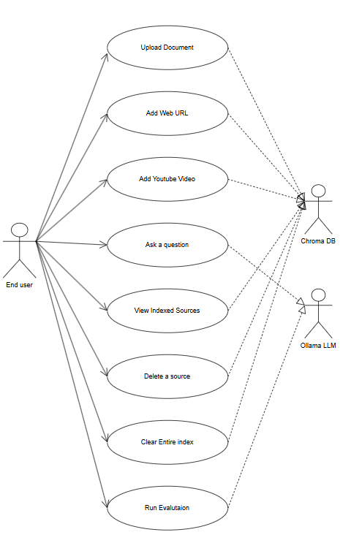
Use Case Diagram
MALLA REDDY COLLEGE OF ENGINEERING AND TECHNOLOGY
B.Tech IV Year – II Sem | Dept of Computational Intelligence| Project Phase - II | Project Review

Slide 15
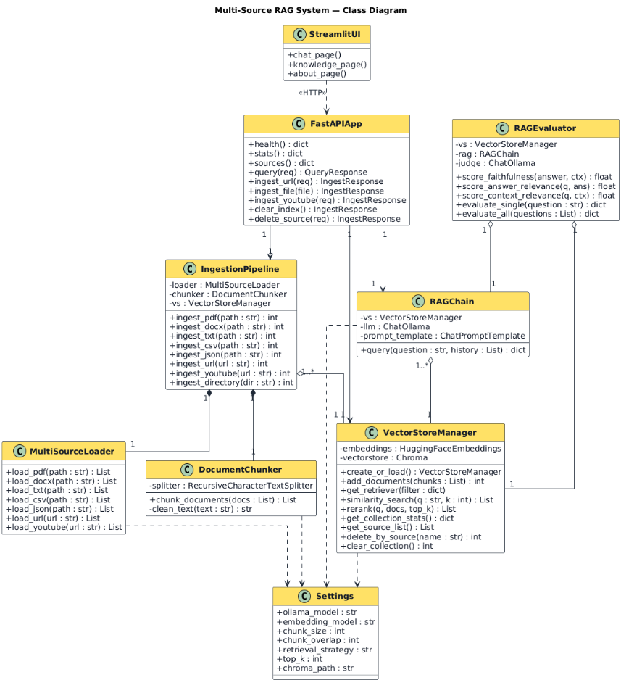
Class Diagram
MALLA REDDY COLLEGE OF ENGINEERING AND TECHNOLOGY
B.Tech IV Year – II Sem | Dept of Computational Intelligence| Project Phase - II | Project Review

Slide 16
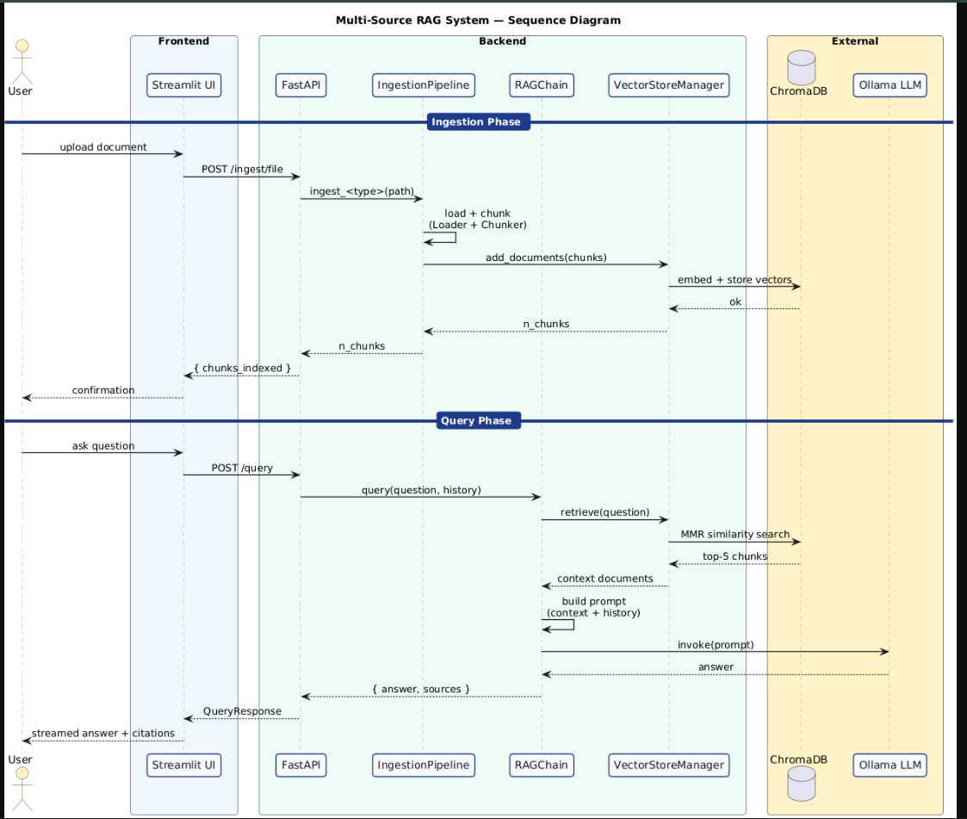
Sequence Diagram
MALLA REDDY COLLEGE OF ENGINEERING AND TECHNOLOGY
B.Tech IV Year – II Sem | Dept of Computational Intelligence| Project Phase - II | Project Review

Slide 17
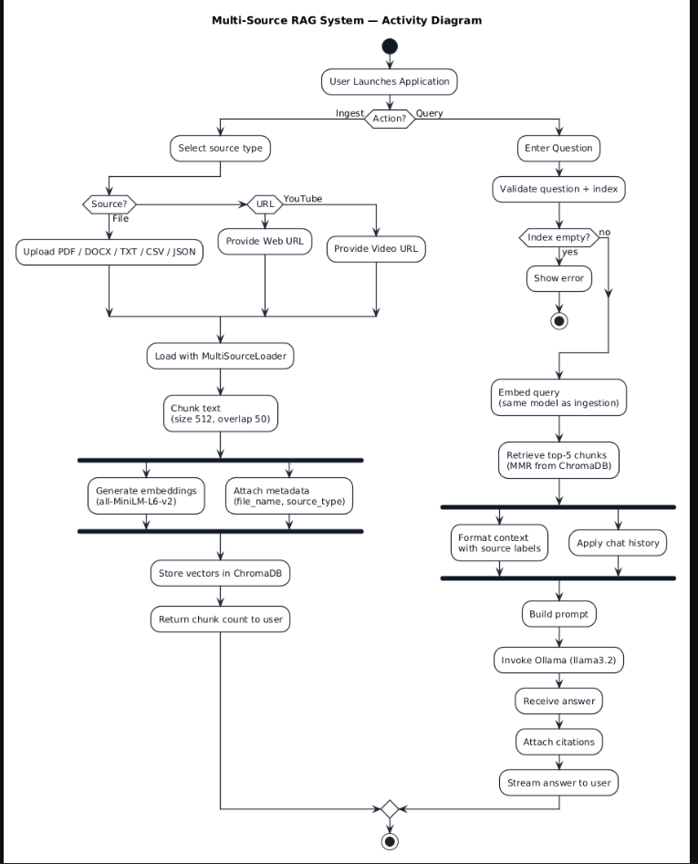
Activity Diagram
MALLA REDDY COLLEGE OF ENGINEERING AND TECHNOLOGY
B.Tech IV Year – II Sem | Dept of Computational Intelligence| Project Phase - II | Project Review

Slide 18
Implementation
MALLA REDDY COLLEGE OF ENGINEERING AND TECHNOLOGY
B.Tech IV Year – II Sem | Dept of Computational Intelligence| Project Phase - II | Project Review

Slide 19
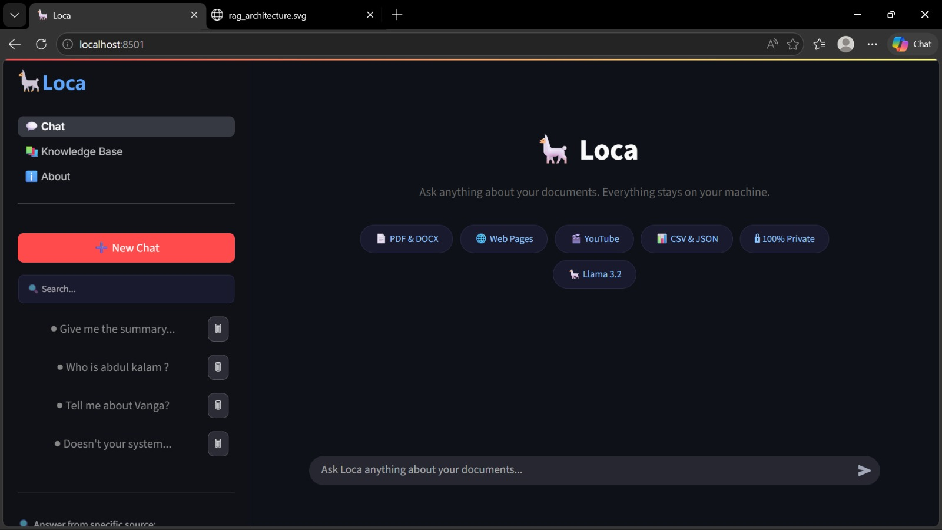
Chat Inteface
MALLA REDDY COLLEGE OF ENGINEERING AND TECHNOLOGY
B.Tech IV Year – II Sem | Dept of Computational Intelligence| Project Phase - II | Project Review

Slide 20
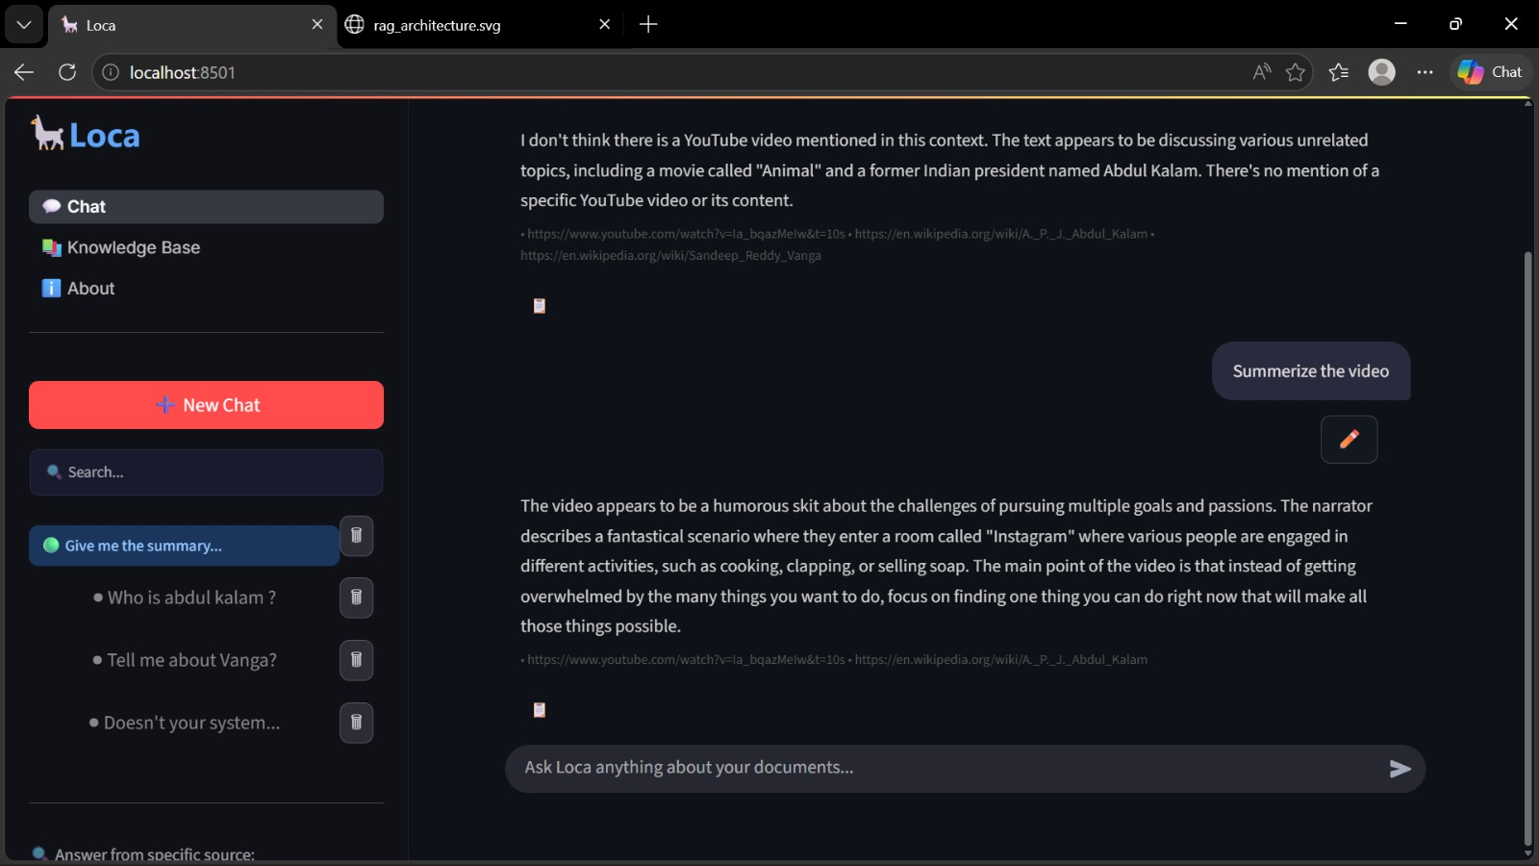
Query Response With Source Attribution
MALLA REDDY COLLEGE OF ENGINEERING AND TECHNOLOGY
B.Tech IV Year – II Sem | Dept of Computational Intelligence| Project Phase - II | Project Review

Slide 21
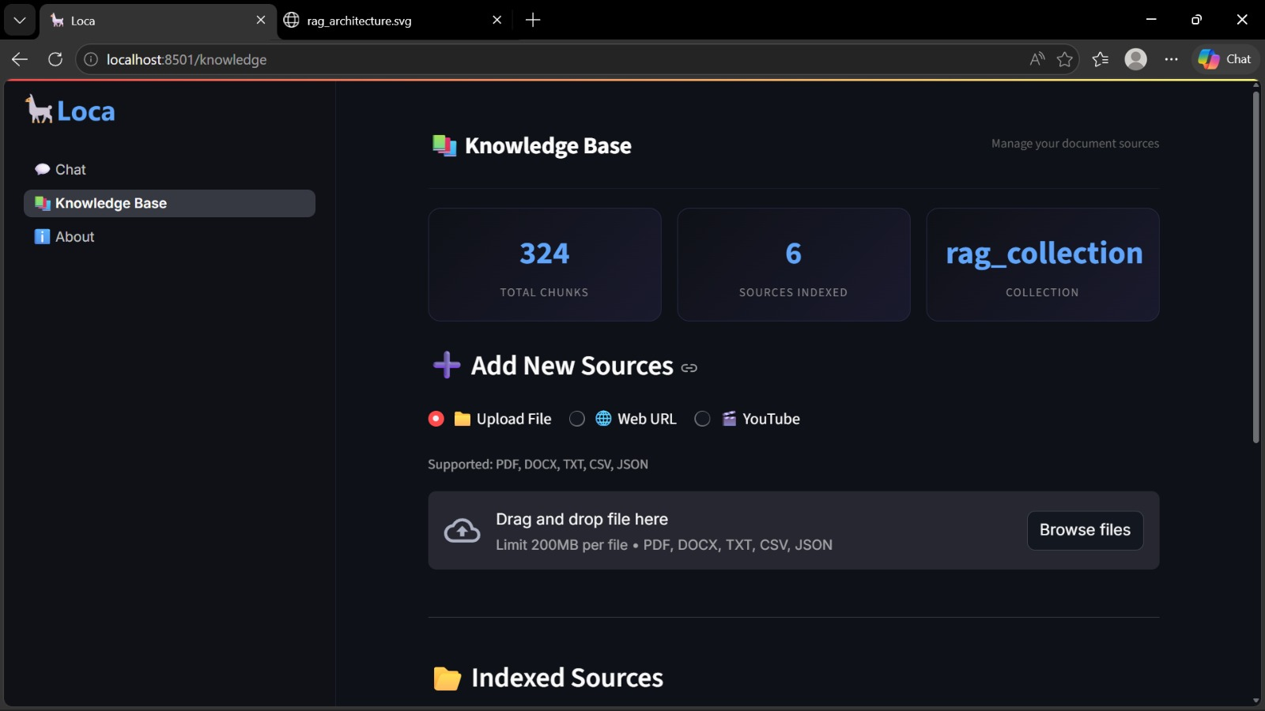
Document upload and Ingestion screen
MALLA REDDY COLLEGE OF ENGINEERING AND TECHNOLOGY
B.Tech IV Year – II Sem | Dept of Computational Intelligence| Project Phase - II | Project Review

Slide 22
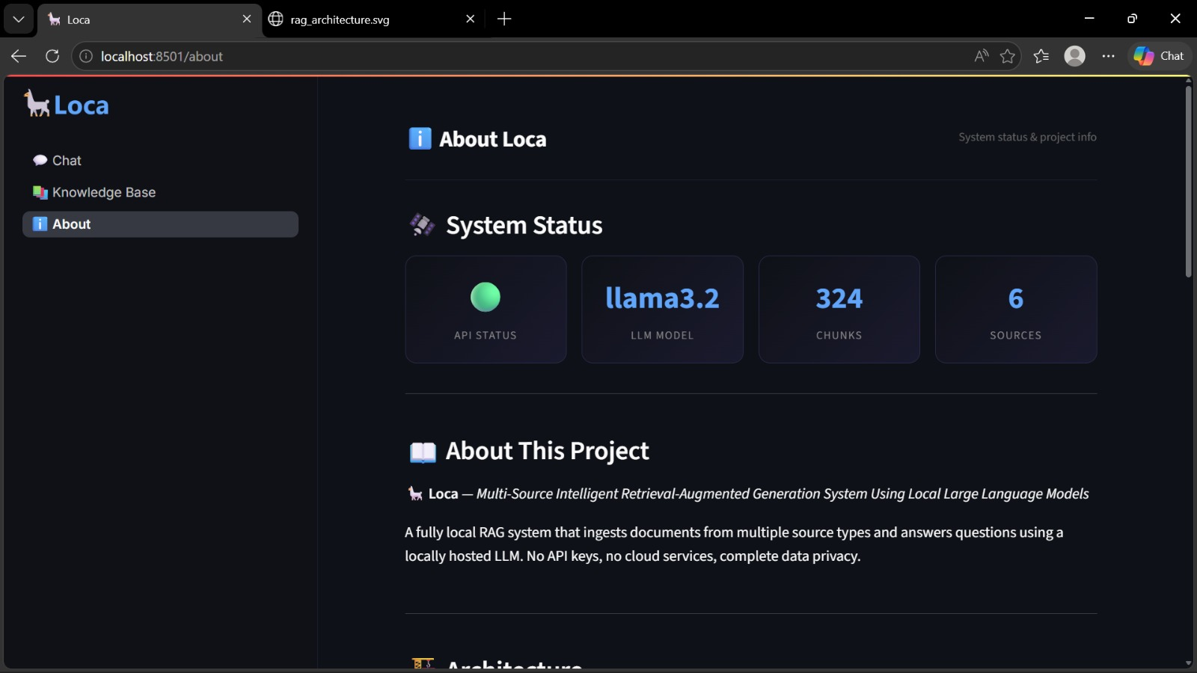
About Screen
MALLA REDDY COLLEGE OF ENGINEERING AND TECHNOLOGY
B.Tech IV Year – II Sem | Dept of Computational Intelligence| Project Phase - II | Project Review

Slide 23
Conclusion
MALLA REDDY COLLEGE OF ENGINEERING AND TECHNOLOGY
In conclusion, this project successfully demonstrates the design and implementation of a fully local Multi-Source Intelligent RAG System Using Local LLMs, capable of ingesting and reasoning over PDF, DOCX, TXT, web, and YouTube content without depending on any cloud service. By integrating LangChain for orchestration, ChromaDB for vector storage, HuggingFace all-MiniLM-L6-v2 for embeddings, and Ollama with llama3.2 for on-device generation, the system achieves accurate, private, and source-attributed question answering. The use of MMR retrieval ensures contextual diversity, while the FastAPI +Streamlit stack provides a smooth real-time user experience for uploading documents and querying knowledge in natural language. The integrated LLM-as-a-judge evaluation module further validates the system's faithfulness, answer relevance, and context relevance, confirming the reliability of generated responses. Overall, this work highlights how privacy-preserving, offline RAG architectures can rival cloud-based solutions in usability and accuracy, offering a scalable and cost-free framework suitable for academic research, enterprise knowledge management, and personal productivity. The project reinforces the growing importance of local LLM ecosystems in building intelligent, trustworthy, and user-controlled AI applications.
B.Tech IV Year – II Sem | Dept of Computational Intelligence| Project Phase - II | Project Review

Slide 24
References
MALLA REDDY COLLEGE OF ENGINEERING AND TECHNOLOGY
Lewis, P., Perez, E., Piktus, A., Petroni, F., Karpukhin, V., Goyal, N., ... & Kiela, D. (2020). Retrieval-Augmented Generation for Knowledge-Intensive NLP Tasks. Advances in Neural Information Processing Systems, 33, 9459-9474.
Reimers, N., & Gurevych, I. (2019). Sentence-BERT: Sentence Embeddings using Siamese BERT-Networks. Proceedings of EMNLP-IJCNLP 2019.
LangChain Documentation. Available at: https://python.langchain.com/docs/
ChromaDB Documentation. Available at: https://docs.trychroma.com/
Ollama Documentation. Available at: https://ollama.com/
Wang, L., Yang, N., Huang, X., Jiao, B., Yang, L., Jiang, D., ... & Wei, F. (2023). Text Embeddings by Weakly-Supervised Contrastive Pre-training. arXiv preprint arXiv:2212.03533.
B.Tech IV Year – II Sem | Dept of Computational Intelligence| Project Phase - II | Project Review

Slide 25
Thank you
MALLA REDDY COLLEGE OF ENGINEERING AND TECHNOLOGY
1.R. Koushik –22N31A66F3
2.V. Sreeja –22N31A66J0
3.S. Vennela –22N31A66J4
B.Tech IV Year – II Sem | Dept of Computational Intelligence| Project Phase - II | Project Review

